Slide 1

jBilling Mediation
Developers training

Slide 2

Topics
What is mediation
Why mediate
How mediation works in jbilling 3
configuration
exercise

Slide 3
What is Mediation?
Me-di-ate
To resolve or settle
To intervene
Mediation is the backbone of a Telecom Billing system
jBilling is a Enterprise Billing System well suited for the Telecom Industry
The Mediation module is responsible for collecting, validating, translating and sometimes rating these transactions for the billing system

Slide 4
Topics
What is mediation
Why mediate
How mediation works in jbilling 3
configuration
exercise

Slide 5
Why Mediate?
In Telecom, purchases happen over network elements (Voice, SMS, Data, MMS, etc)
All these purchases need to be billed correctly for generating correct invoices/bills
Records in another systems are most likely in proprietary format

Slide 6

Why Mediate?
Calls Detail Record (CDR)
Orders
1 | sdd | 34 | 3edrfg | 56
2 | sjws | 26 | edrfgt | 43
.. | wer | 3 | sdfg | 34
1m | cds | 48 | dsg | 34
1 | sdd | 2s | s
2 | siws | s | s
3 | wer | s | s
Mediation

Slide 7
Topics
What is mediation
Why mediate
How mediation works in jbilling 3
Mediation components
Mediation steps
configuration
exercise

Slide 8
Mediation Components
Reader - Imediationreader
Mediation processor - imediationprocess
Mediation task - ischeduledtask
Mediation error handler - imediationerrorhandler

Slide 9
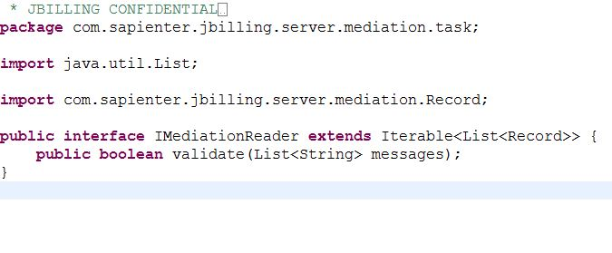
Mediation Components
Mediation Reader

Slide 10
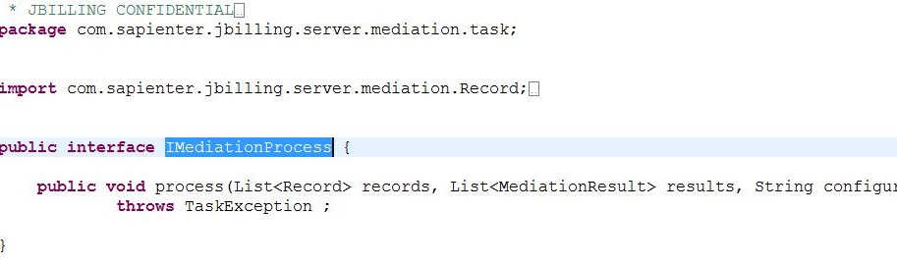
Mediation Components
Mediation Processor

Slide 11
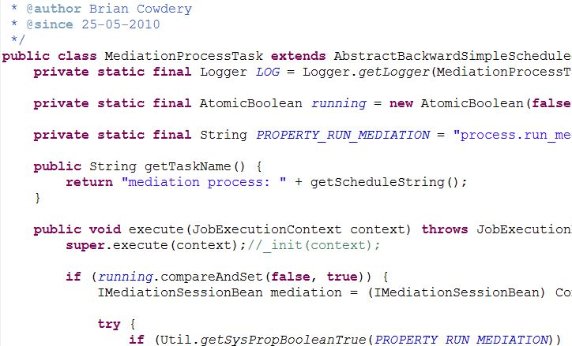
Mediation Components
Mediation Task

Slide 12
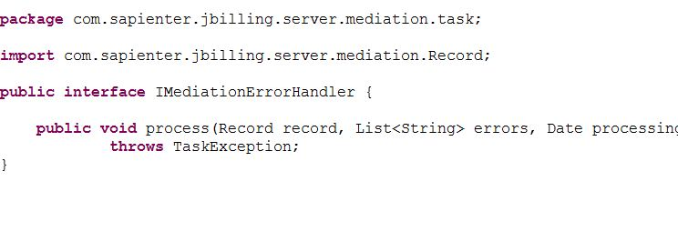
Mediation Components
Mediation Error Handler

Slide 13
Mediation Components
Summary
Mediation
Task
1
(Trigger)
Calls Detail Record (CDR)
1 | sdd | 34 | 3edrfg | 56
2 | sjws | 26 | edrfgt | 43
.. | wer | 3 | sdfg | 34
1m | cds | 48 | dsg | 34
Mediation
Process
Mediation
Reader
2
3
Orders
1 | sdd | 2s | s
2 | siws | s | s
3 | wer | s | s

Slide 14
Mediation Process
Steps
Resolve User
Resolve Currency & Date
Resolve Current Order
Line Creation
Resolve Price (external)
Resolve Item
Item Management
(external)

Slide 15
Topics
What is mediation
Why mediate
How mediation works in jbilling 3
configuration
exercise

Slide 16
Configuration
Plug-ins
Define reader plug-in
Mediation process
Mediation configuration
No configuration, no mediation

Slide 17
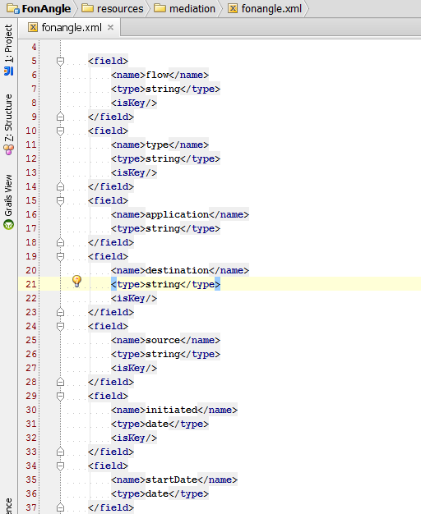
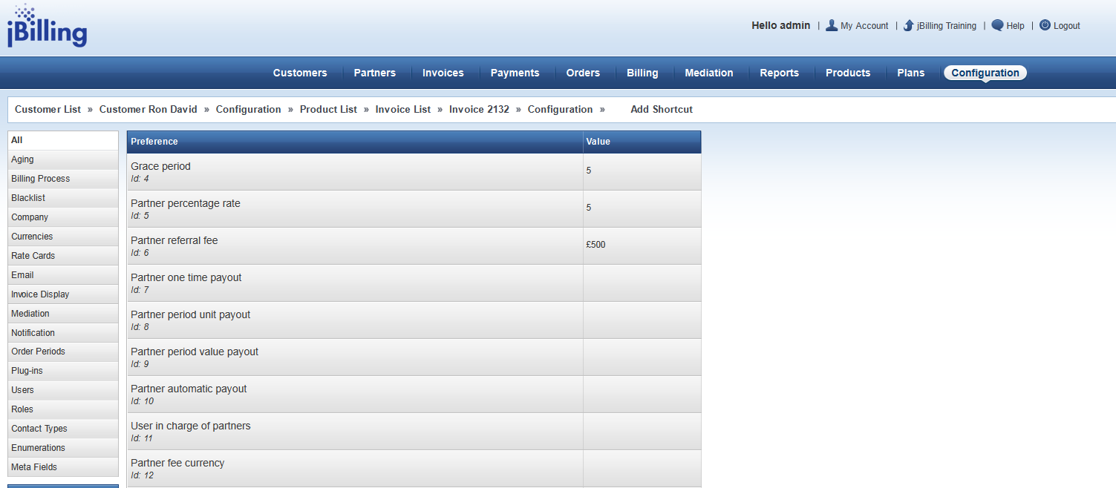
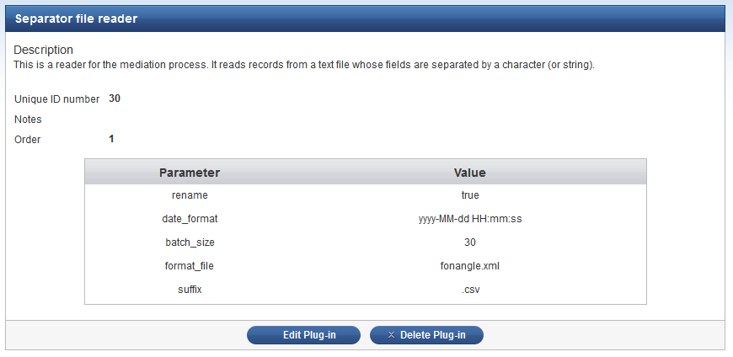
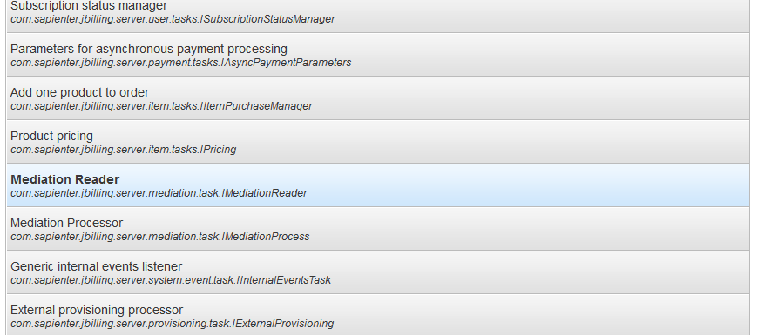
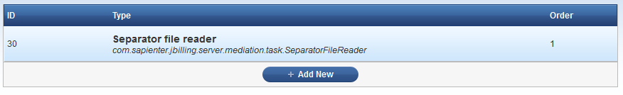
Configuration
Plugins - Reader
1
3
2

Slide 18
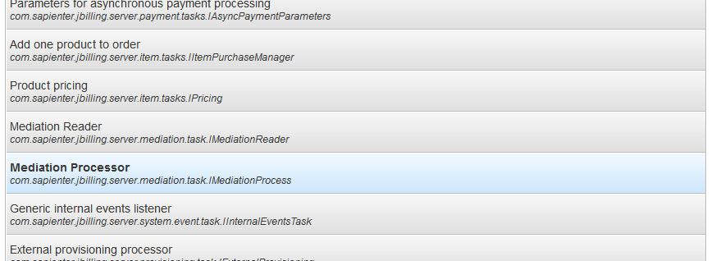
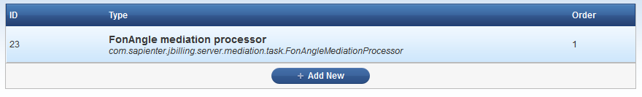
Configuration
Plugins - Processor
1
3
2

Slide 19
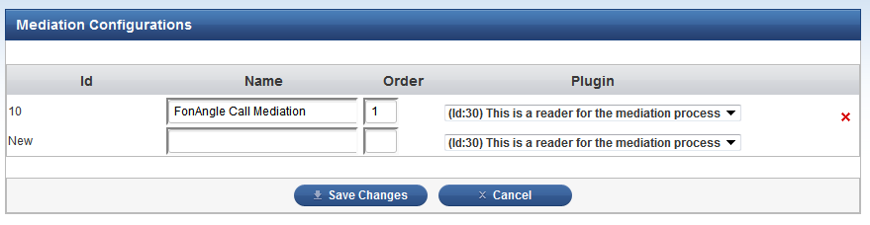
Configuration
Mediation – 3.1
1
2

Slide 20
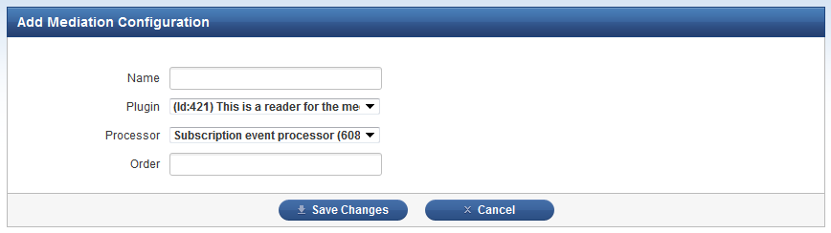
Configuration
Mediation – 3.2

Slide 21
Topics
What is mediation
Why mediate
How mediation works in jbilling 3
configuration
exercise

Slide 22
Exercise
Create a Java Based mediation processor:
Resolve product by id.
Skip calls from numbers that start with 101.
Skip calls with zero duration.
Find user by username.

Slide 23
Useful Links
Jbilling user’s manual: http://jbilling.com/files/jBilling_3_docs.zip
1.7 CHAPTER 6 MEDIATION
wiki

